Slide 1
CONTENTS
Software life cycle models:
Waterfall model
Prototype model

Slide 2
Software Life Cycle Models
The goal of Software Engineering is to provide models and processes that lead to the production of well-documented maintainable software in a manner that is predictable.
“The period of time that starts when a software product is conceived and ends when the product is no longer available for use. The software life cycle typically includes a requirement phase, design phase, implementation phase, test phase, installation and check out phase, operation and maintenance phase, and sometimes retirement
phase”.

Slide 3
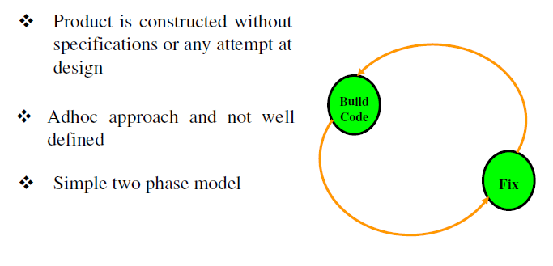
Build & Fix Model

Slide 4
Suitable for small programming exercises of 100 or 200 lines
Unsatisfactory for software for any reasonable size
Code soon becomes unfixable & unenhanceable
No room for structured design
Maintenance is practically not possible

Slide 5
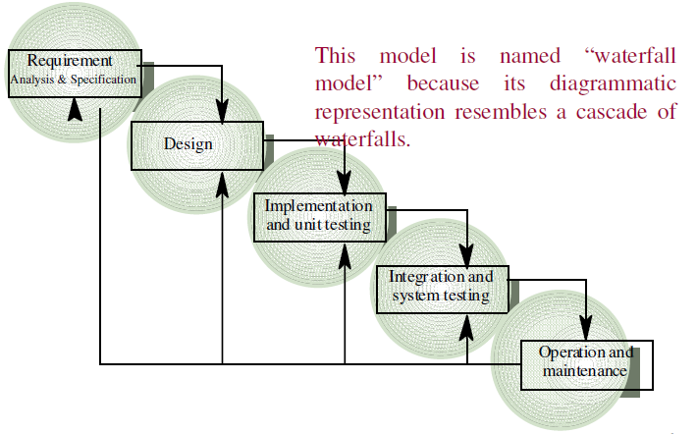
Waterfall Model

Slide 6
This model is easy to understand and reinforces the notion of “define before design” and “design before code”. The model expects complete & accurate requirements early in the process, which is unrealistic
Problems of waterfall model
It is difficult to define all requirements at the beginning of a project
ii. This model is not suitable for accommodating any change
iii. A working version of the system is not seen until late in the project’s life
iv. It does not scale up well to large projects.
v. Real projects are rarely sequential.

Slide 7
Incremental Process Models
They are effective in the situations where requirements are defined precisely and there is no confusion about the functionality of the final product.
After every cycle a useable product is given to the customer.
Popular particularly when we have to quickly deliver a limited
functionality system.

Slide 8
Iterative Enhancement Model
This model has the same phases as the waterfall model, but with fewer restrictions. Generally the phases occur in the same order as in the waterfall model, but they may be conducted in several cycles. Useable product is released at the end of the each cycle, with each release providing additional functionality.
Customers and developers specify as many requirements as possible and prepare a SRS document.
Developers and customers then prioritize these requirements
Developers implement the specified requirements in one or more cycles of design, implementation and test based on the defined priorities.

Slide 9
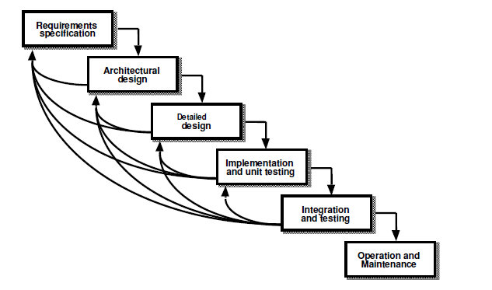
Iterative Enhancement Model

Slide 10
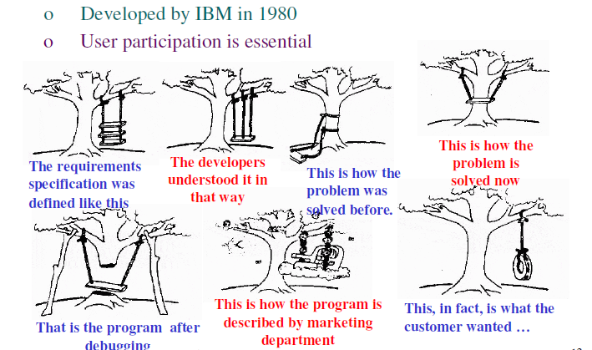
The Rapid Application Development (RAD) Model

Slide 11
What is RAD (Rapid Application Development) Model?
RAD or Rapid Application Development process is an adoption of the waterfall model; it targets at developing software in a short span of time. RAD follow the iterative SDLC RAD model has following phases :
1. Business Modeling
2. Data Modeling
3. Process Modeling
4. Application Generation
5. Testing and Turnover

Slide 12
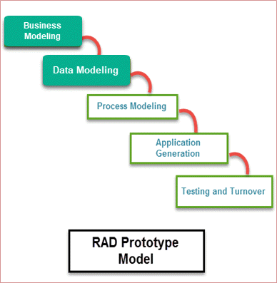

Slide 13
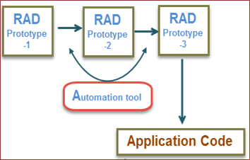
It focuses on input-output source and destination of the information.
It emphasizes on delivering projects in small pieces; the larger projects are divided into a series of smaller projects.
The main features of RAD model are that it focuses on the reuse of templates, tools, processes, and code.

Slide 14
ADVANATAGES :
Flexible and adaptable to changes
It is useful when you have to reduce the overall project risk
It is adaptable and flexible to changes
With less people, productivity can be increased in short time
DISADVANTAGES :
It can't be used for smaller projects
Not all application is compatible with RAD
When technical risk is high, it is not suitable
If developers are not committed to delivering software on time, RAD projects can fail
Requires highly skilled designers or developers

Slide 15
Prototyping Model
The basic idea in Prototype model is that instead of freezing the requirements before a design or coding can proceed, a throwaway prototype is built to understand the requirements.
This prototype is developed based on the currently known requirements.
By using this prototype, the client can get an “actual feel” of the system, since the interactions with prototype can enable the client to better understand the requirements of the desired system.
The prototype are usually not complete systems and many of the details are not built in the prototype. The goal is to provide a system with overall functionality.

Slide 16
ADVANTAGES OF PROTOTYPE MODEL:
Users are actively involved in the development
Since in this methodology a working model of the system is provided, the
users get a better understanding of the system being developed.
Errors can be detected much earlier.
Quicker user feedback is available leading to better solutions.
Missing functionality can be identified easily
Confusing or difficult functions can be identified
Requirements validation, Quick implementation of, incomplete, but
functional, application.

Slide 17
Disadvantages of Prototype model:
Leads to implementing and then repairing way of building systems.
Practically, this methodology may increase the complexity of the system as
scope of the system may expand beyond original plans.
Incomplete application may cause application not to be used, as the
full system was designed incomplete or inadequate problem analysis.

Slide 18
When to use Prototype model:
Prototype model should be used when the desired system needs to have a lot of interaction with the end users. (INTERACTION)
Typically, online systems, web interfaces have a very high amount of interaction with end users, are best suited for Prototype model. It might take a while for a system to be built that allows ease of use and needs minimal training for the end user. (MINIMAL SKILLS/TRAINING REQUIRED)
Prototyping ensures that the end users constantly work with the system and provide a feedback which is incorporated in the prototype to result in a useable system. They are excellent for designing good human computer interface systems. (FEEDBACK SUPPORT SYSTEM)

Slide 19
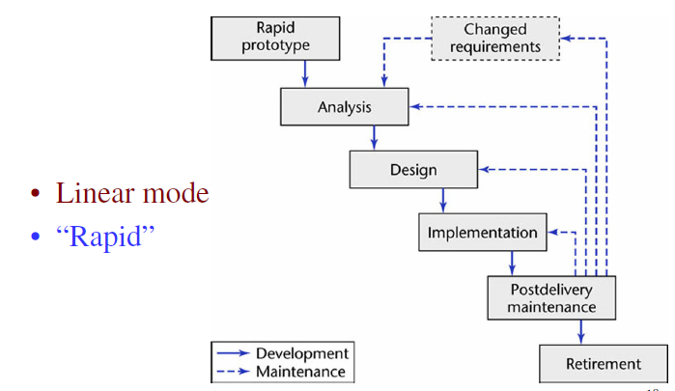
Prototyping Model

Slide 20
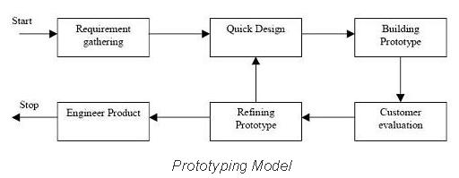
Diagram of Prototype model:

Slide 21
QUESTIONS
Q-1. What are the advantages of developing the prototype of a system?
Q-2. List the advantages of using waterfall model instead of adhoc build and fix model?
Q-3. Which phase is not available in software life cycle?
Coding
(b) Testing
(c) Maintenance
(d) Abstraction

Slide 22
Q-4. Waterfall model is not suitable for
small projects
accommodating change
(c) complex projects
(d) none of the above
Q-5. Build and fix model has
3 phases
1 phase
(c) 2 phases
(d) 4 phases

Slide 23
THANK YOU

